Slide 1
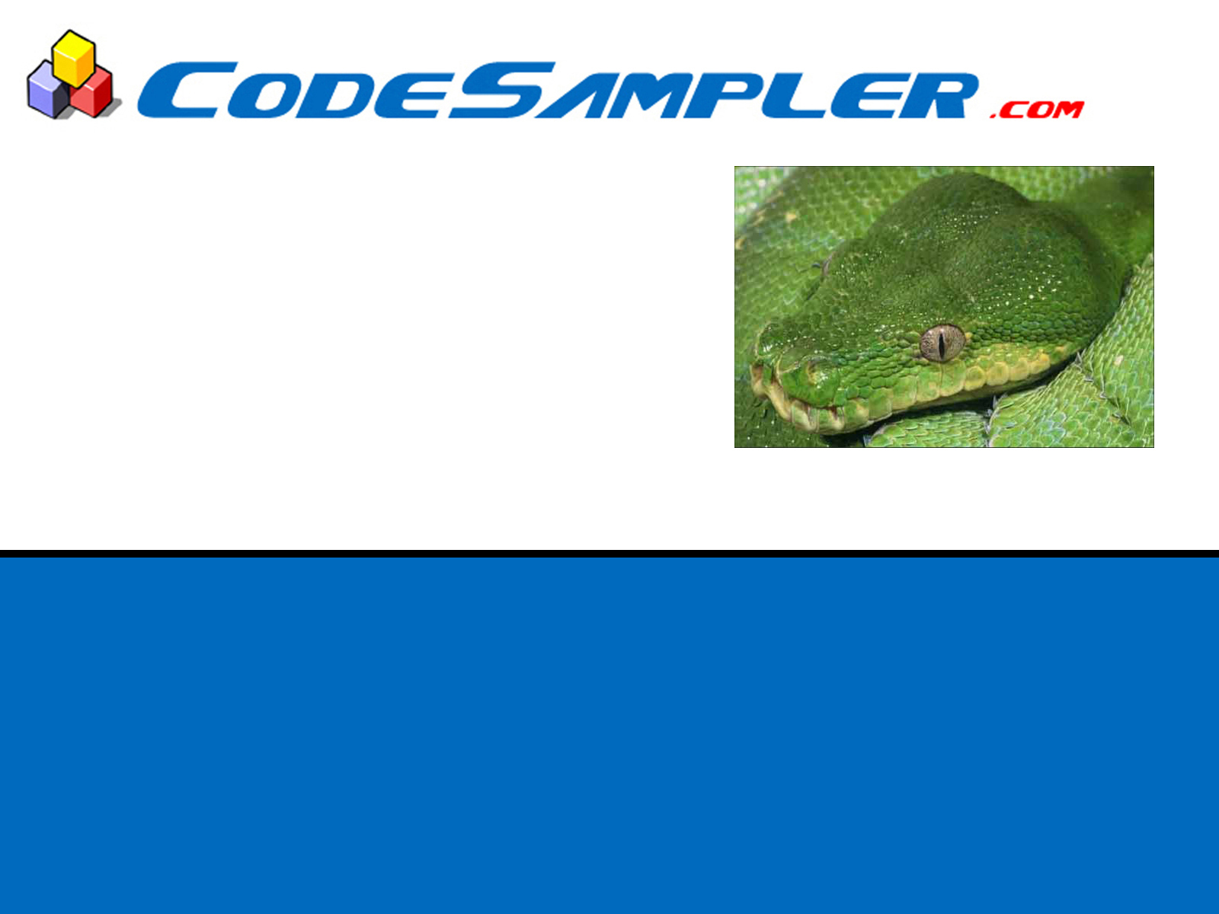
Please make sure you have python 2.7.x on your machines.
No Lower or higher versions please.
You can download it from python.org

Slide 2
An Introduction to Python
Ramesh S

Slide 3
What is Python?
Python is a high level programming language created by Guido van Rossum.
Developed at National Research Institute for Mathematics and Computer Science in the Netherlands.
Currently maintained by Python Software Foundation.
Named after the British comedy troupe, Monty Python’s Flying Circus.
First released in 1991

Slide 4

Guido van Rossam
Benevolent Dictator for Life (BDFL)
- Python Software Foundation.

Slide 5
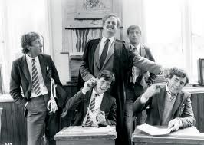
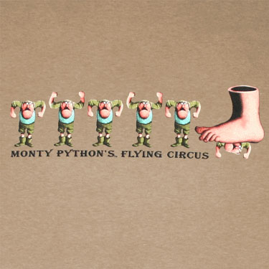
Monty Python Flying Circus

Slide 6
Python Relase History
Python 3.3.2 (May 2013)
Python 3.2.5 (May 2013)
Python 3.1.5 (April 2012)
Python 3.0.1 (February 2009)
Python 2.7.5 (May 2013)
Python 2.6.8 (April 2012)
Python 2.5.6 (May 2011)
Python 2.4.6 (Dec 2008)
Python 2.3.7 (March 2008)
Python 2.2.3 (May 2003)
Python 2.1.3 (April 2002)
Python 2.0.1 (June 2001)
Python 1.6.1 (Sep 2000)
Python 1.5.2 (April 1999)

Slide 7
What is Python?
Python is an
easy to learn,
powerful programming language.
It has efficient
high-level data structures
and a simple but effective approach to
object-oriented programming.
Python’s
elegant syntax and
dynamic typing,
together with its
interpreted nature,
make it an ideal language for
scripting and
rapid application development
in many areas on most platforms.

Slide 8
Design Goals
Designed to be simple yet powerful
Allow modular programming
Great emphasis on readability
Rapid application development
Easy to embed in & extend with other languages

Slide 9
Philosophy of Python
import this

Slide 10
Why Python?
So, why use Python over other scripting languages?
Well tested and widely used
Great documentation
Strong community support
Widely Cross-platform
Open sourced
Can be freely used and distributed, even for commercial purposes.

Slide 11
Where is Python used
Scripting
Rapid Prototyping
Text Processing
Web applications
GUI programs
Game Development
Database Applications
System Administration Automation

Slide 12
Who is using Python
Used by large organizations
  NASA
  Google
  Microsoft
  eBay
  PayPal
  Dropbox
  OpenStack
Used in published games
  Battlefield 2
  Civilization IV
  Disney’s Toontown Online

Slide 13
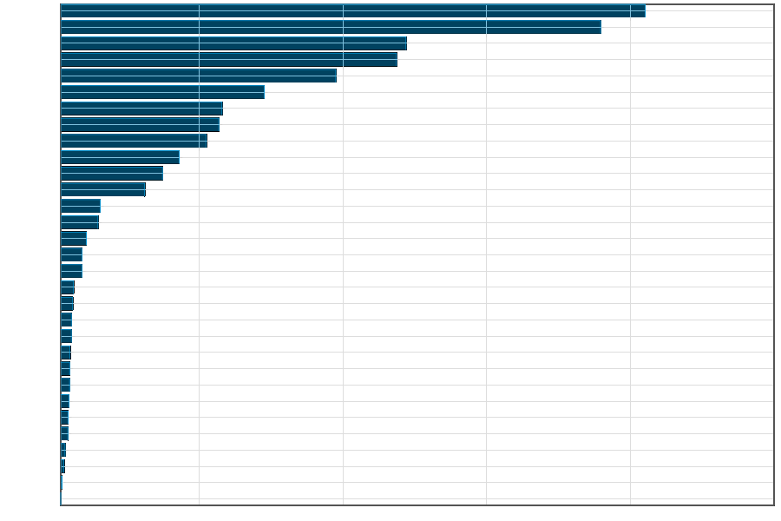
How popular is Python
Java
C
C++
Javascript
PHP
Python………
SQL
Perl
C#

Slide 14
Learning Python is Easy - Check these out

Slide 15
What does this program do?
print "Hello World"

Slide 16
What does this program do?
count=0
while count<11:
print count
count+=1

Slide 17
What does this program do?
kids=['Lahari','Lalitha','Jithu','Vishal','Ujwal','Nitesh']
for kid in kids:
print kid

Slide 18
What does this program do?
kids=['Lahari','Lalitha','Jithu','Vishal','Ujwal','Nitesh']
for kid in kids:
if len(kid)==6:
print kid

Slide 19
What does this program do?
kids=['Lahari','Lalitha','Jithu','Vishal','Ujwal','Nitesh']
for kid in kids:
if "it" in kid:
print kid

Slide 20
What does this program do?
marks={'maths':97,'science':'98','history':78}
for subject,marks in marks.items():
print subject,marks

Slide 21
What does this program do?
f=open('dictionary.txt','r')
for line in f:
if line.startswith('s'):
print line

Slide 22
What does this program do?
f=open('words.txt','r')
j=open('new-words.txt','w')
j.write(f.read())
f.close()
j.close()

Slide 23
What does this program do?
def factorial(n):
fact=1
for x in range(n,1,-1):
fact*=x
return fact
print factorial(4)

Slide 24
What does this program do?
squares=[]
for x in range(1,100):
squares.append(x*x)
print squares

Slide 25
How do I edit Python?
IDLE is a free GUI based text editor which ships with Python.
You could just write your scripts with Notepad, but IDLE has many helpful features like keyword highlighting.
Click your “Start” button and Find “Python 3.1” on your “All Programs” menu. Then select and run “IDLE (Python GUI)”.
You can also right-click on any python script (.py) and select “Edit with IDLE” to open it.

Slide 26
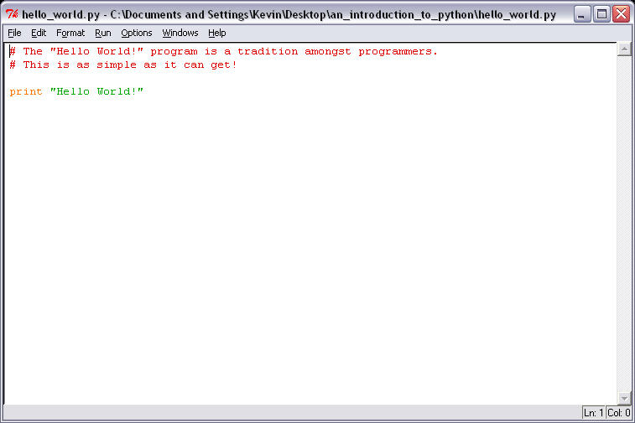
IDLE in Action

Slide 27
“Hello World!”
The “Hello World!” example is a tradition amongst programmers, so lets start there…
Run IDLE and type in the following
print( “Hello World!” )
Save your work and hit F5 to run it.
The script simply prints the string, “Hello World!” to the console.

Slide 28
The print function
The print function simply outputs a string value to our script’s console.
print( “Hello World!” )
It’s very useful for communicating with users or outputting important information.
print( “Game Over!” )
We get this function for free from Python.
Later, we’ll learn to write our own functions.

Slide 29
Adding Comments
Comments allow us to add useful information to our scripts, which the Python interpreter will ignore completely.
Each line for a comment must begin with the number sign ‘#’.
# This is a programming tradition…
print ( “Hello World!” )
Do yourself a favor and use them!

Slide 30
Quoting Strings
Character strings are denoted using quotes.
You can use double quotes…
print( “Hello World!” ) # Fine.
Or, you can use single quotes…
print( ‘Hello World!’ ) # Also fine.
It doesn’t matter as long as you don’t mix them
print( “Hello World!’ ) # Syntax Error!

Slide 31
Triple Quotes
You can even use triple quotes, which make quoting multi-line strings easier.
print( “““
This is line one.
This is line two.
This is line three.
Etc…
””” )

Slide 32
Strings and Control Characters
There are several control characters which allow us to modify or change the way character strings get printed by the print function.
They’re composed of a backslash followed by a character. Here are a few of the more important ones:
\n : New line
\t : Tabs
\\ : Backslash
\' : Single Quote
\" : Double Quote

Slide 33
Variables
Like all programming languages, Python variables are similar to variables in Algebra.
They act as place holders or symbolic representations for a value, which may or may not change over time.
Here are six of the most important variable types in Python:
int Plain Integers ( 25 )
long Long Integers ( 4294967296 )
float Floating:point Numbers ( 3.14159265358979 )
bool Booleans ( True, False )
str Strings ( “Hello World!” )
list Sequenced List ( [25, 50, 75, 100] )

Slide 34
Type:less Variables
Even though it supports variable types, Python is actually type:less, meaning you do not have to specify the variable’s type to use it.
You can use a variable as a character string one moment and then overwrite its value with a integer the next.
This makes it easier to learn and use the language but being type:less opens the door to some hard to find bugs if you’re not careful.
If you’re uncertain of a variable’s type, use the type function to verify its type.

Slide 35
Rules for Naming Variables
You can use letters, digits, and underscores when naming your variables.
But, you cannot start with a digit.
var = 0 # Fine.
var1 = 0 # Fine.
var_1= 0 # Fine.
_var = 0 # Fine.
1var = 0 # Syntax Error!

Slide 36
Rules for Naming Variables
Also, you can’t name your variables after any of Python’s reserved keywords.
and, del, for, is, raise, assert, elif, from, lambda, return, break, else, global, not, try, class, except, if, or, while, continue, exec, import, pass, yield, def, finally, in, print

Slide 37
Numerical Precision
Integers
  Generally 32 signed bits of precision
  [2,147,483,647 .. –2,147,483,648]
  or basically (-2³² , 2³²)
  Example: 25
Long Integers
  Unlimited precision or size
  Format: <number>L
  Example: 4294967296L
Floating:point
  Platform dependant “double” precision
  Example: 3.141592653589793

Slide 38
Type Conversion
The special constructor functions int, long, float, complex, and bool can be used to produce numbers of a specific type.
For example, if you have a variable that is being used as a float, but you want to use it like an integer do this:
myFloat = 25.12
myInt = 25
print( myInt + int( myFloat ) )
With out the explicit conversion, Python will automatically upgrade your addition to floating-point addition, which you may not want especially if your intention was to drop the decimal places.

Slide 39
Type Conversion
There is also a special constructor function called str that converts numerical types into strings.
myInt = 25
myString = "The value of 'myInt' is "
print( myString + str( myInt ) )
You will use this function a lot when debugging!
Note how the addition operator was used to join the two strings together as one.

Slide 40
Arithmetic Operators
Arithmetic Operators allow us to perform mathematical operations on two variables or values.
Each operator returns the result of the specified operation.
+ Addition
- Subtraction
* Multiplication
/ Float Division
// Floor Division
** Exponent
abs Absolute Value

Slide 41
Comparison Operators
Comparison Operators return a True or False value for the two variables or values being compared.
< Less than
<= Less than or equal to
> Greater than
>= Greater than or equal to
== Is equal to
!= Is not equal to

Slide 42
Operator Precedence
lambda Lambda Expression
if - else Conditional expression
or Boolean OR
and Boolean AND
not x Boolean NOT
in, not in, is, is not, <, <=, >, >=, !=, == Comparisons, including
membership tests and identity tests
| Bitwise OR
ˆ Bitwise XOR
& Bitwise AND
<<, >> Shifts
+, - Addition and subtraction
*, /, //, % Multiplication, Division, Floor Division and Remainder
+x, -x, ~x Positive, Negative, bitwise NOT
** Exponentiation
x[index], x[index-index], x(arguments...), x.attribute Subscription,
slicing, call, attribute reference
(expressions...), [expressions...], {key- value...}, {expressions...}
Binding or tuple display, list display, dictionary display, set display

Slide 43
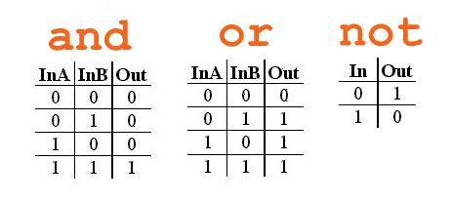
Boolean Operators
Python also supports three Boolean Operators, and, or, and not, which allow us to make use of Boolean Logic in our scripts.
Below are the Truth Tables for and, or, and not.

Slide 44
Boolean Operators
Suppose that… var1 = 10.
The and operator will return True if and only if both comparisons return True.
print( var1 == 10 and var1 < 5 ) (Prints False)
The or operator will return True if either of the comparisons return True.
print( var1 == 20 or var1 > 5 ) (Prints True)
And the not operator simply negates or inverts the comparison’s result.
print( not var1 == 10 ) (Prints False)

Slide 45
Special String Operators
It may seem odd but Python even supports a few operators for strings.
Two strings can be joined (concatenation) using the + operator.
print( “Game ” + “Over!” )
Outputs “Game Over!” to the console.
A string can be repeated (repetition) by using the * operator.
print( “Bang! ” * 3 )
Outputs “Bang! Bang! Bang! ” to the console.

Slide 46
Lists
Dynamically resizable
Indexable
Slicable
append(), insert(), extend()
pop(), remove()
index(), count()
sort(), reverse()
'in' operator for presence check

Slide 47
Tuple
Immutable list
Indexable
Slicable
index(), count()
'in' operator for presence check

Slide 48
Dictionary
key - value pairs
key required to access a value
keys must be unique
values need not be
insertion order not maintained
keys(), values(), items()
get(), has_key()
pop(), popitem()

Slide 49
Set
unordered collection of unique items
union()
intersection()
'-' operator supported
add()
remove()

Slide 50
Flow Control
Flow Control allows a program or script to alter its flow of execution based on some condition or test.
The most important keywords for performing Flow Control in Python are if, else, elif, for, and while.

Slide 51
If Statement
The most basic form of Flow Control is the if statement.
# If the player’s health is less than or equal to 0 - kill him!
if health <= 0:
print( “You’re dead!” )
Note how the action to be taken by the if statement is indented or tabbed over. This is not a style issue – it’s required.
Also, note how the if statement ends with a semi-colon.

Slide 52
If-else Statement
The if-else statement allows us to pick one of two possible actions instead of a all-or-nothing choice.
health = 75
if health <= 0:
print( “You're dead!” )
else:
print( “You're alive!” )
Again, note how the if and else keywords and their actions are indented. It’s very important to get this right!

Slide 53
If-elif-else Statement
The if-elif-else statement allows us to pick one of several possible actions by chaining two or more if statements together.
health = 24
if health <= 0:
print( "You're dead!")
elif health < 25:
print( "You're alive - but badly wounded!")
else:
print( "You're alive!")

Slide 54
Multiple elif
if hour == 0:
# midnight
elif hour == 6:
# morning
elif hour == 17:
# evening
else:
print "Good Day!"

Slide 55
while Statement
The while statement allows us to continuously repeat an action until some condition is satisfied.
numRocketsToFire = 3
rocketCount = 0
while rocketCount < numRocketsToFire:
# Increase the rocket counter by one
rocketCount = rocketCount + 1
print( “Firing rocket #” + str( rocketCount ) )
This while statement will continue to ‘loop’ and print out a “Firing rocket” message until the variable “rocketCount” reaches the current value of “numRocketsToFire”, which is 3.

Slide 56
for Statement
The for statement allows us to repeat an action based on the iteration of a Sequenced List.
weapons = [ “Pistol”, “Rifle”, “Grenade”, “Rocket Launcher” ]
print “-- Weapon Inventory --”
for x in weapons:
print( x)
The for statement will loop once for every item in the list.
Note how we use the temporary variable ‘x’ to represent the current item being worked with.

Slide 57
break Keyword
The break keyword can be used to escape from while and for loops early.
numbers = [100, 25, 125, 50, 150, 75, 175]
for x in numbers:
print( x )
# As soon as we find 50 - stop the search!
if x == 50:
print( "Found It!“ )
break;
Instead of examining every list entry in “numbers”, The for loop above will be terminated as soon as the value 50 is found.

Slide 58
continue Keyword
The continue keyword can be used to short-circuit or bypass parts of a while or for loop.
numbers = [100, 25, 125, 50, 150, 75, 175]
for x in numbers:
# Skip all triple digit numbers
if x >= 100:
continue;
print( x )
The for loop above only wants to print double digit numbers. It will simply continue on to the next iteration of the for loop if x is found to be a triple digit number.

Slide 59
Functions
A function allows several Python statements to be grouped together so they can be called or executed repeatedly from somewhere else in the script.
We use the def keyword to define a new function.

Slide 60
Defining functions
Below, we define a new function called “printGameOver”, which simply prints out, “Game Over!”.
def printGameOver():
print( “Game Over!” )
Again, note how indenting is used to denote the function’s body and how a semi-colon is used to terminate the function’s definition.

Slide 61
Function arguments
Often functions are required to perform some task based on information passed in by the user.
These bits of Information are passed in using function arguments.
Function arguments are defined within the parentheses “()”, which are placed at the end of the function’s name.

Slide 62
Function arguments
Our new version of printGameOver, can now print out customizable, “Game Over!”, messages by using our new argument called “playersName”.
def printGameOver( playersName ):
print( “Game Over... ” + playersName + “!” )
Now, when we call our function we can specify which player is being killed off.

Slide 63
Default Argument Values
Once you add arguments to your function, it will be illegal to call that function with out passing the required arguments.
The only way around this it is to specify a default argument value.

Slide 64
Default Argument Values
Below, the argument called “playersName” has been assigned the default value of, “Guest”.
def printGameOver( playersName=“Guest” ):
print( “Game Over... ” + playersName + “!” )
If we call the function and pass nothing, the string value of “Guest” will be used automatically.

Slide 65
Multiple Function arguments
If we want, we can define as many arguments as we like.
def printGameOver( playersName, totalKills ):
print( “Game Over... ” + playersName + “!” )
print( “Total Kills: ” + str( totalKills ) + “\n” )
Of course, we must make sure that we pass the arguments in the correct order or Python will get confused.
printGameOver( "camper_boy", 15 ) # Correct!
printGameOver( 12, "killaHurtz" ) # Syntax Error!

Slide 66
Keyword arguments
If you really want to change the order of how the arguments get passed, you can use keyword arguments.
def printGameOver( playersName, totalKills ):
print( “Game Over... ” + playersName + “!” )
print( “Total Kills: ” + str( totalKills ) + “\n” )
printGameOver( totalKills=12, playersName=“killaHurtz” )
Note how we use the argument’s name as a keyword when calling the function.

Slide 67
Function Return Values
A function can also output or return a value based on its work.
The function below calculates and returns the average of a list of numbers.
def average( numberList ):
numCount = 0
runningTotal = 0
for n in numberList:
numCount = numCount + 1
runningTotal = runningTotal + n
return runningTotal / numCount
Note how the list’s average is returned using the return keyword.

Slide 68
Assigning the return value
Here’s how the return value of our average function would be used…
myNumbers = [5.0, 7.0, 8.0, 2.0]
theAverage = average( myNumbers )
print( "The average of the list is " + str( theAverage ) + "." )
Note how we assign the return value of average to our variable called “theAverage”.

Slide 69
Multiple Return Values
A function can also output more than one value during the return.
This version of average not only returns the average of the list passed in but it also returns a counter which tells us how many numbers were in the list that was averaged.
def average( numberList ):
numCount = 0
runningTotal = 0
for n in numberList:
numCount = numCount + 1
runningTotal = runningTotal + n
return runningTotal / numCount, numCount
Note how the return keyword now returns two values which are separated by a comma.

Slide 70
Assigning the return values
Here’s how the multiple return value of our average function could be used…
myNumbers = [5.0, 7.0, 8.0, 2.0]
theAverage, numberCount = average( myNumbers )
print( "The average of the list is " + str( theAverage ) + ".“ )
print( "The list contained " + str( numberCount ) + " numbers.“)
Note how we assign the return values of average to our variables “theAverage” and “numberCount”.

Slide 71
Functions
Simple Function
Function with agruments
Function with default agruments
Function with multiple returns
Calling a function with keyword arguments
Variable length parameters using *
Combination of * and **

Slide 72
Introspection commands
id
type
dir
help

Slide 73
File I/O - common scenarios
Read file contents at once f=open('input.txt','r') print( f.read()) f.close() | Read all lines into a list f=open('input.txt','r') lines= f.readlines() print( lines) f.close()
Read file char by char f=open('input.txt','r') print( f.read(1)) f.close() | Write into a new file f=open('input.txt','w') f.write("this is line one\n") f.close()
Read file line by line f=open('input.txt','r') print( f.readline()) f.close() | Append to an existing file f=open('input.txt','a') f.write("this is a new line \n") f.close()

Slide 74
File I/O - all commands
open()
close()
read()
readline()
readlines()
write()
writelines()
seek()
tell()
flush()
closed

Slide 75
File modes
r : read
w : write
a : append
U : universal new line support
r+ : read & write
w+ : write & read
a+ : append & read
rb : read in binary mode
wb : write in binary mode
ab : append in binary mode

Slide 76
Modules
Generic import
Universal import
Function import
Function import with rename
default name space
dir
help

Slide 77
Sample Module
mymodule.py
name='python'
def add(a,b,c):
return a+b+c
def sub(a,b):
return a-b
myprogram.py
from mymodule import *
print name
print add(2,3,4)
print sub(7,3)

Slide 78
Sample Module
mymodule.py
name='python'
def add(a,b,c):
return a+b+c
def sub(a,b):
return a-b
print __name__
myprogram.py
from mymodule import *
print name
print add(2,3,4)
print sub(7,3)
print __name__

Slide 79
Sample Module
mymodule.py
name='python'
def add(a,b,c):
return a+b+c
def sub(a,b):
return a-b
myprogram.py
from mymodule import *
def main():
  print name
  print add(2,3,4)
  print sub(7,3)
if __name__=='__main__':
main()

Slide 80
Python Sequences
The most basic data structure in Python is the sequence. Each element of a sequence is assigned a number - its position, or index. The first index is zero, the second index is one, and so forth.
6 built-in types of sequences. most common ones are lists and tuples.
There are certain things you can do with all sequence types. These operations include indexing, slicing, adding, multiplying, and checking for membership. In addition, Python has built-in functions for finding the length of a sequence, and for finding its largest and smallest elements.

Slide 81
Python Coding Style
PEP 8 has emerged as the style guide that most projects adhere to; it promotes a very readable and eye-pleasing coding style. Every Python developer should read it at some point; here are the most important points extracted for you:
Use 4-space indentation, and no tabs.
4 spaces are a good compromise between small indentation (allows greater nesting depth) and large indentation (easier to read).
Tabs introduce confusion, and are best left out.
Wrap lines so that they don’t exceed 79 characters.
This helps users with small displays and makes it possible to have several code files side-by-side on larger displays.

Slide 82
Python Coding Style
Use blank lines to separate functions and classes, and larger blocks of code inside functions.
When possible, put comments on a line of their own.
Use docstrings.
Use spaces around operators and after commas, but not directly inside bracketing constructs:
a = f(1, 2) + g(3, 4)
Name your classes and functions consistently; the convention is to use
  CamelCase for classes
  lower_case_with_underscores for functions and methods.

Slide 83
Python Stack
Component | Example
Python Program | HelloWorld.py
Python | Python.exe or python binary
Python ByteCode Interpreter(VM) | Byte Code
Operating System | Windows, Mac, Linux
Hardware | i386, AMD-64, RISC

Slide 84
Phases of program execution
Phase | Output
Editor/IDE | HelloWorld.py
Lexical Analysis | Tokens
Parsing | Abstract Syntax Tree (AST).
Code Generation | Byte Code
Python ByteCode Interpreter (It is a stack based Virtual Machine) | Native Machine Code

Slide 85
Questions
?

Slide 86
Credits
Kevin Harris
(Codesampler.com)

